Slide 1
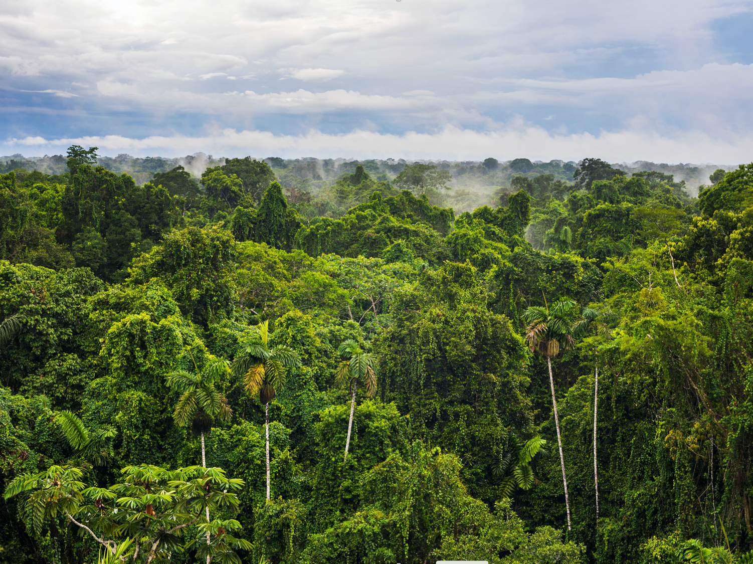
Ontological Issues in Big Earth Observation Data Analysis
Gilberto Camara
https://gilbertocamara.org
https://zenodo.org/record/395640
image: Alamy

Slide 2
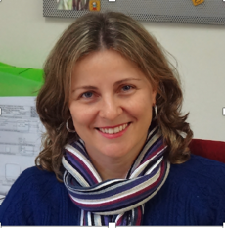
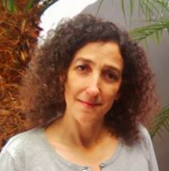
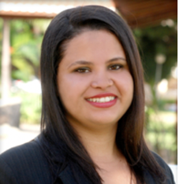


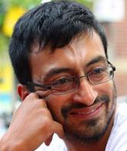
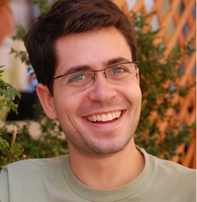
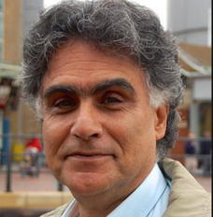
Thanks to the INPE team!
Karine
Lúbia
Adeline
Lorena
Gilberto
Isabel
Michelle
Alber
Pedro
Cartaxo
Victor
Rolf

Slide 3
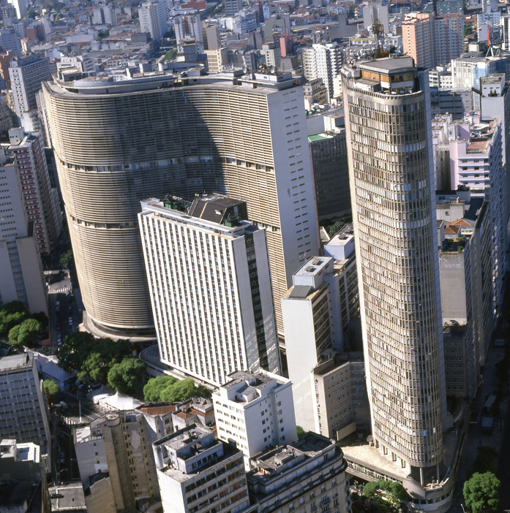
Sustainable development: knowledge and action
Knowledge: informs us about the limits of our planet
Action: societies decide how to use our planet’s resources
images: USGS, Alamy

Slide 4
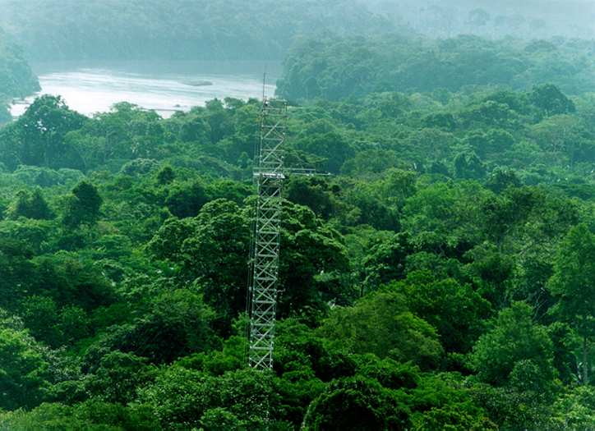
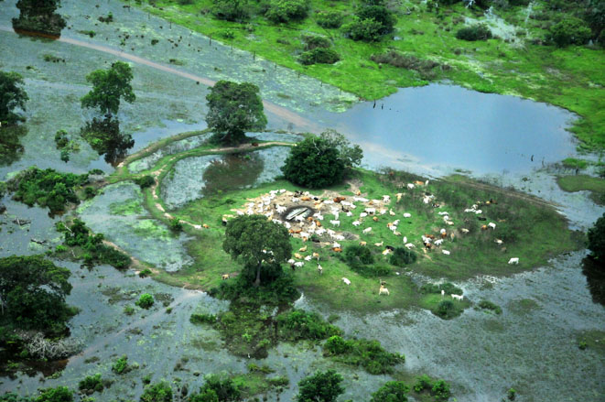
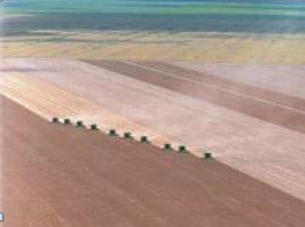
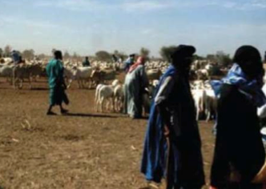
“Ontology aims to reduce the complexity of Nature so our limited intellect can try to understand the Earth’s environment” (Ian Jarvis, GEOGLAM)

Slide 5
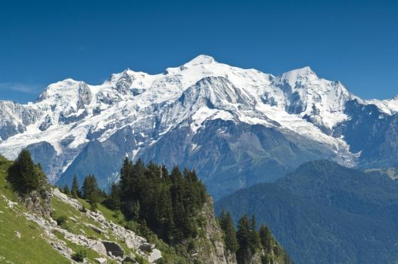

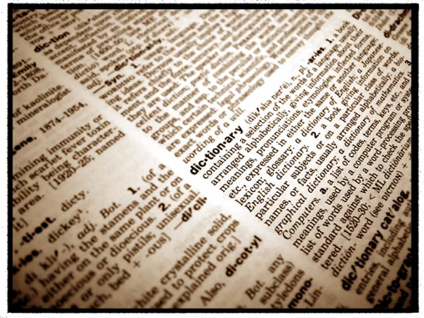
It all begins with observations…
What’s out there?
We use words in our language to describe the world

Slide 6
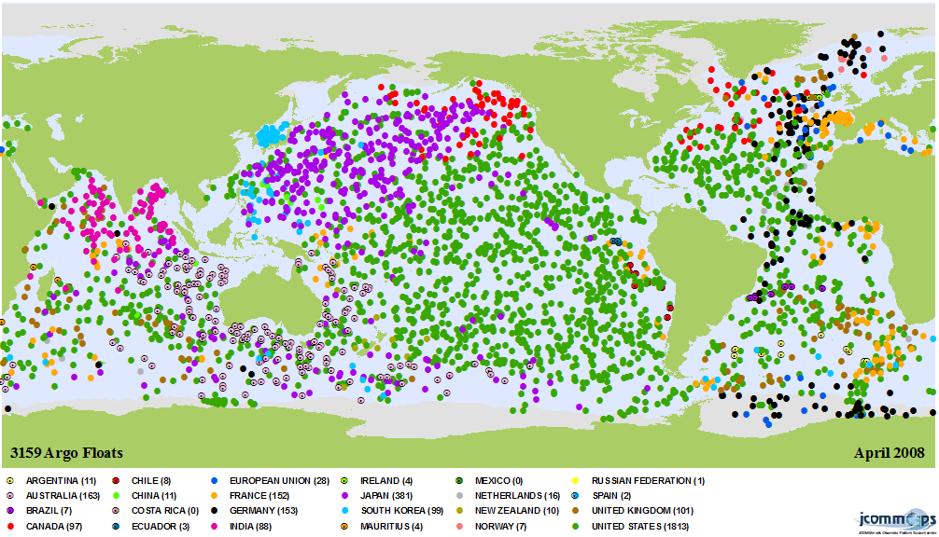
An observation is a measure of a value in a location in space and a position in time

Slide 7
A field is a space-time continuous function that assigns a unique value to a location in spacetime
Sea-surface temperature

Slide 8
What about objects?
Mont Blanc
Objects are language constructs, built upon observations
They require both an external reality and a conscious act to identify their existence

Slide 9
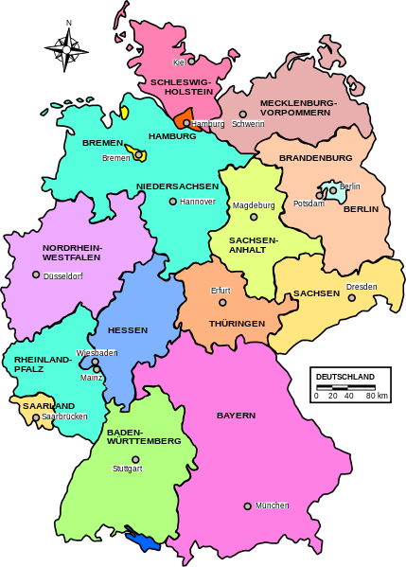
Geospatial ontology: Barry Smith
Fiat and bona fide objects
A bona fide object
(the Sun)
A fiat object
(Germany)

Slide 10
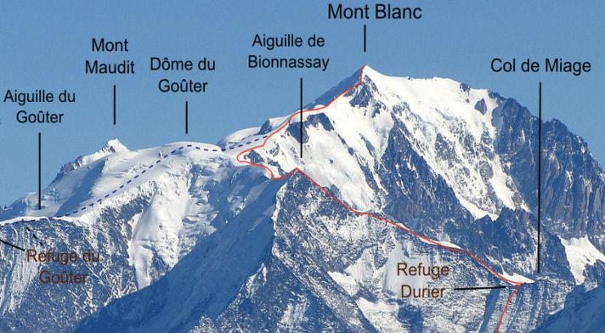
Objects as mental constructions derived from physical reality
Mont Blanc
“Mont Blanc” is a socially-accepted name for a specific topographic feature
Where does “Mont Blanc” start and “Dôme du Goûter” end?

Slide 11
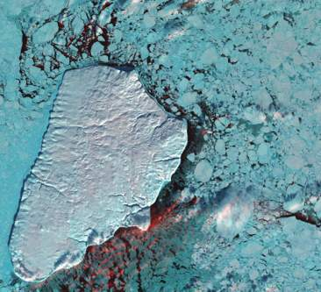
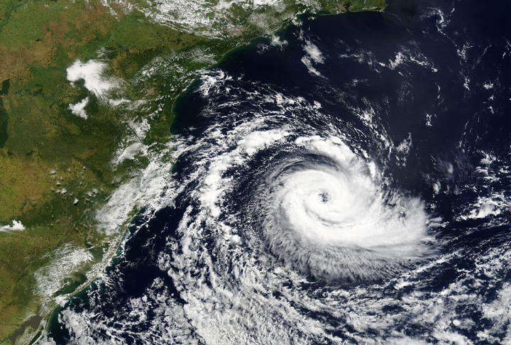
Natural objects are bona fide
What is the size of the coast of England?

Slide 12
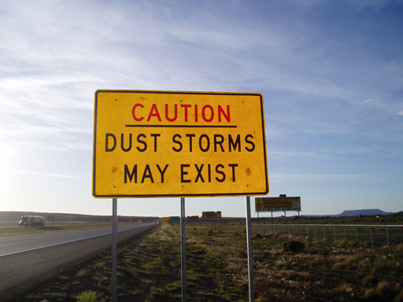

Slide 13
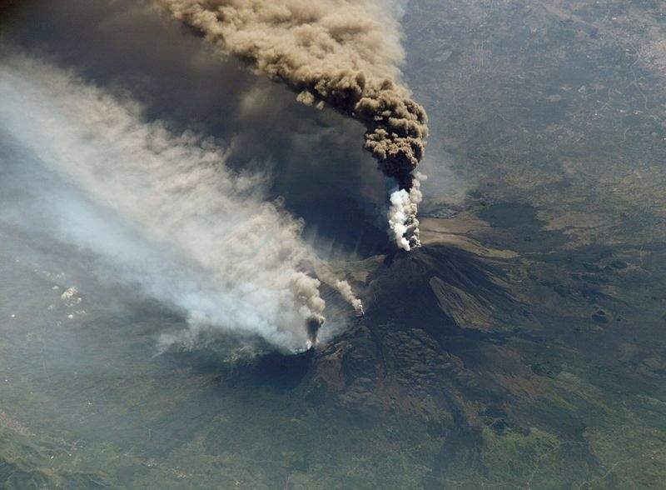
objects exist, events occur
Mount Etna is an object
Etna’s 2002 eruption was an event

Slide 14
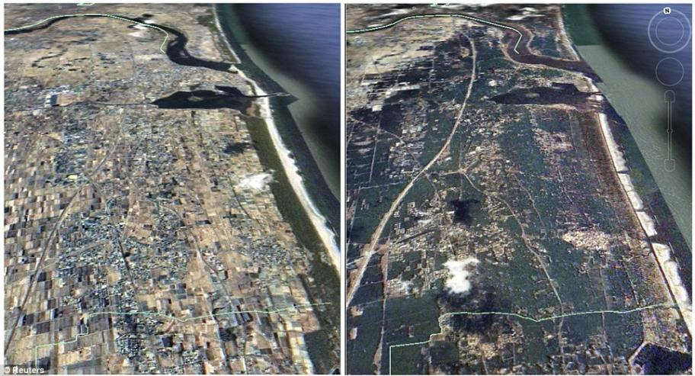
Objects exist, events occur
Japan is an object
The 2011 Tohoku tsunami was an event

Slide 15
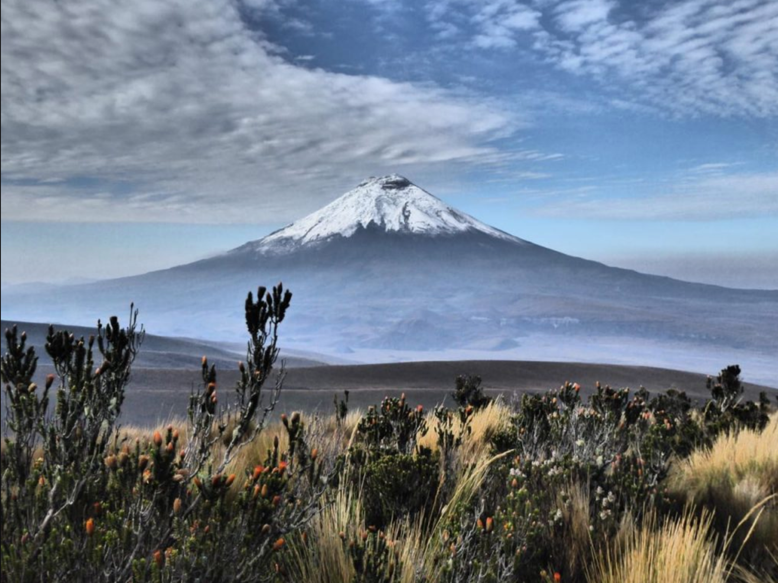
Objects
External Reality
Observations
Fields
Events
“Mount Cotopaxi (object) sits at the top of this mountain ridge (field),
and it last exploded in August 2015 (event)”
image: asa-travel.com

Slide 16
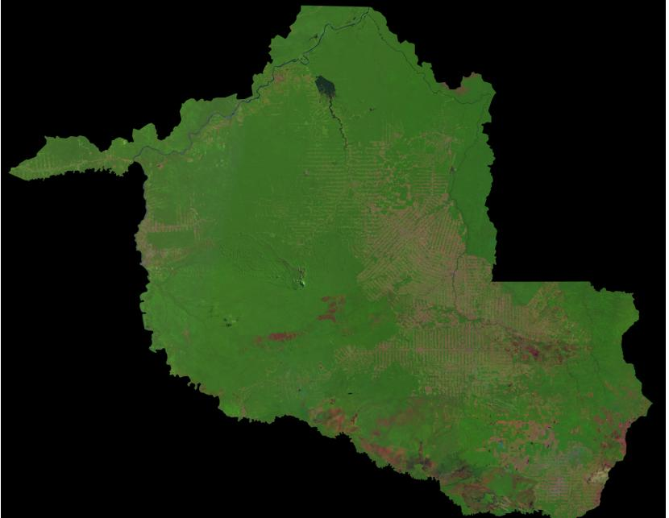
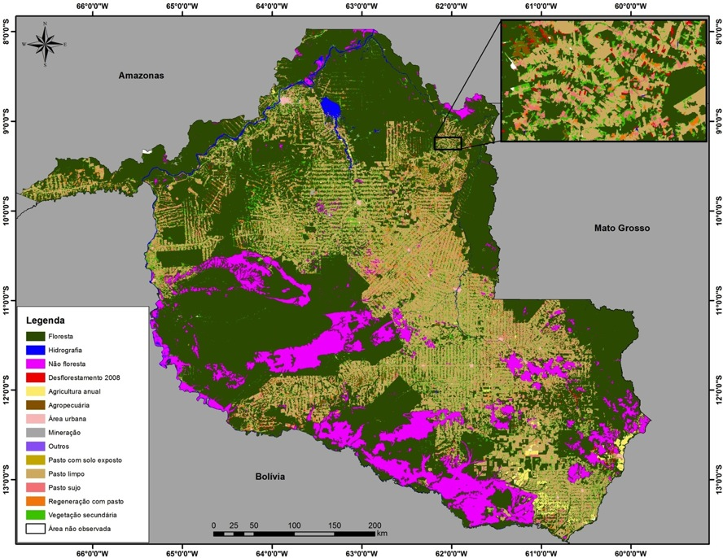
The quest for the perfect map
The world is divided in cells. Each cell has a single class.
There is a correct classification.
The more our classification approaches the ideal, the better.

Slide 17
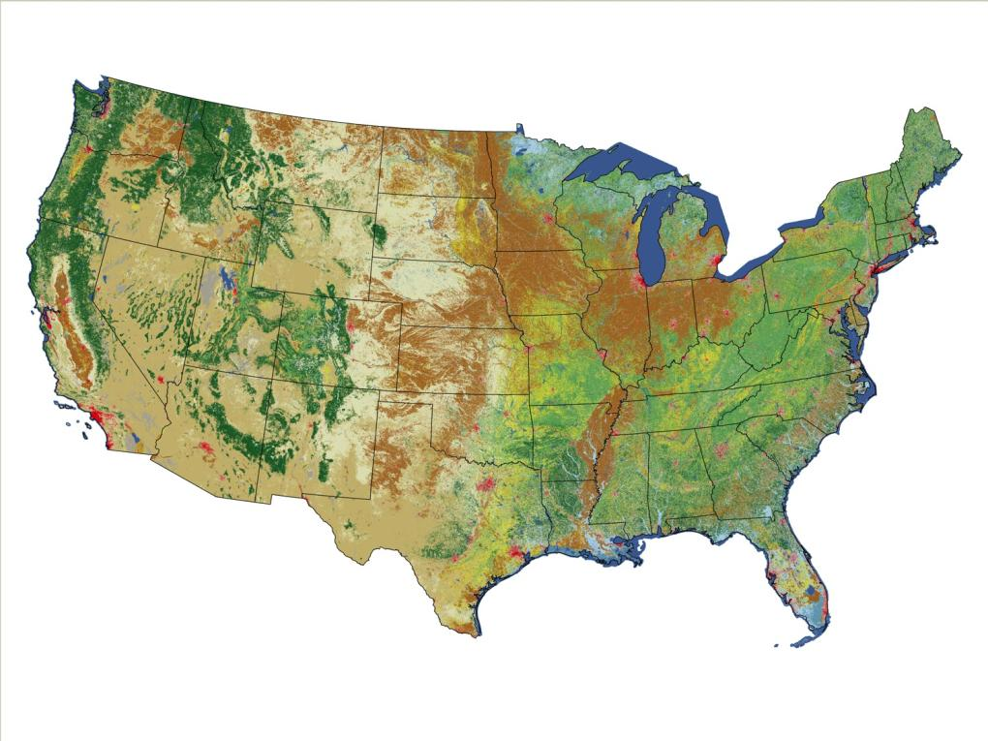
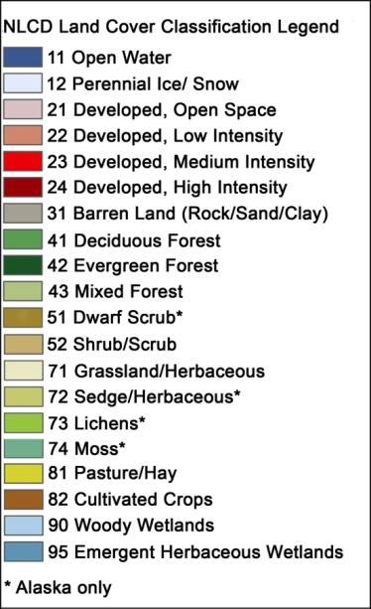
In search of the perfect map
US National Land Cover 2006
source: USGS

Slide 18
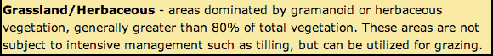
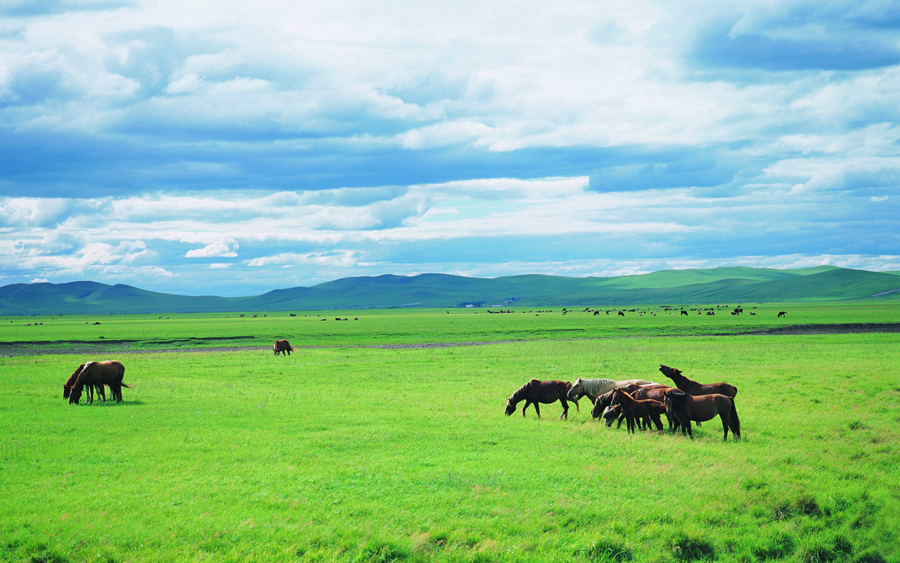
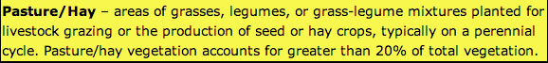
Land cover or land use?

Slide 19


What has changed in the 21st century?
Low access cost
data services
massive use
The new digital economy: data services, social networks, cloud computing, machine learning
images: shutterstock

Slide 20
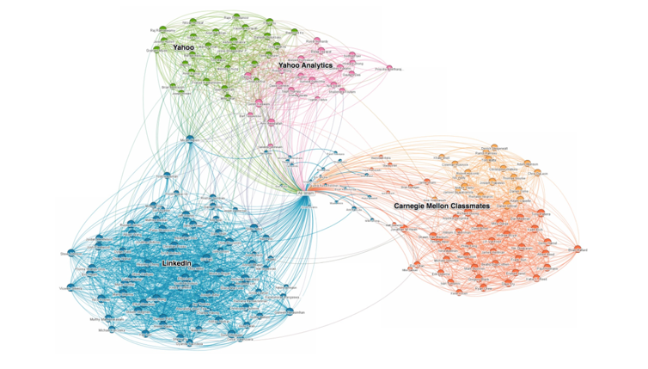
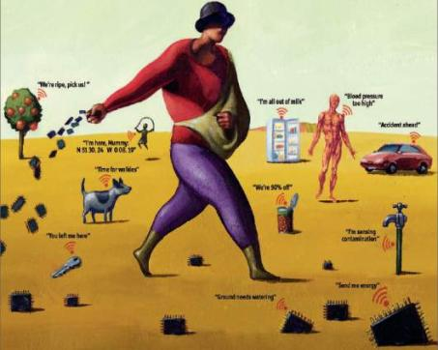
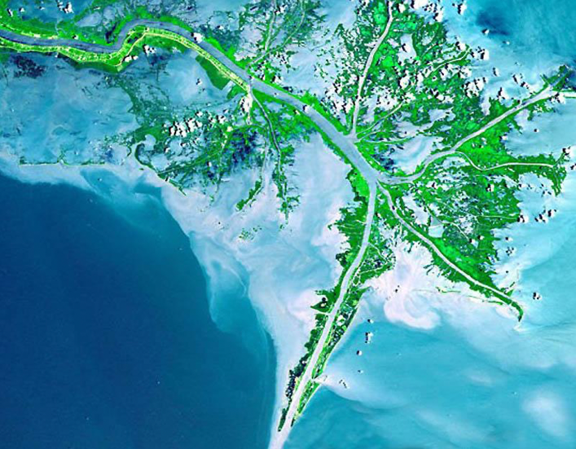
mobile devices
social networks
Mobile devices, social network, big Earth observation sets: new technologies, new challenges
images: Economist, USGS, LinkedIn, tagesanzeiger.ch
sensors everywhere
lots of images

Slide 21
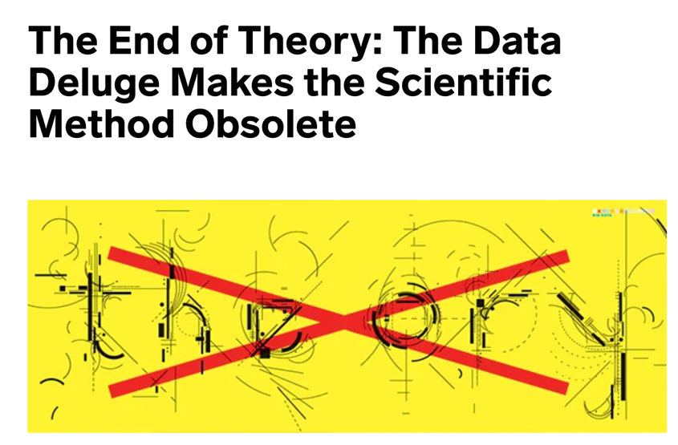
George Box (Univ Wisconsin): “All models are wrong, but some are useful”
Chris Anderson (Wired): “What can Science learn from Google?”
Peter Norvig (Google): “All models are wrong, and increasingly you can succeed without them”.

Slide 22
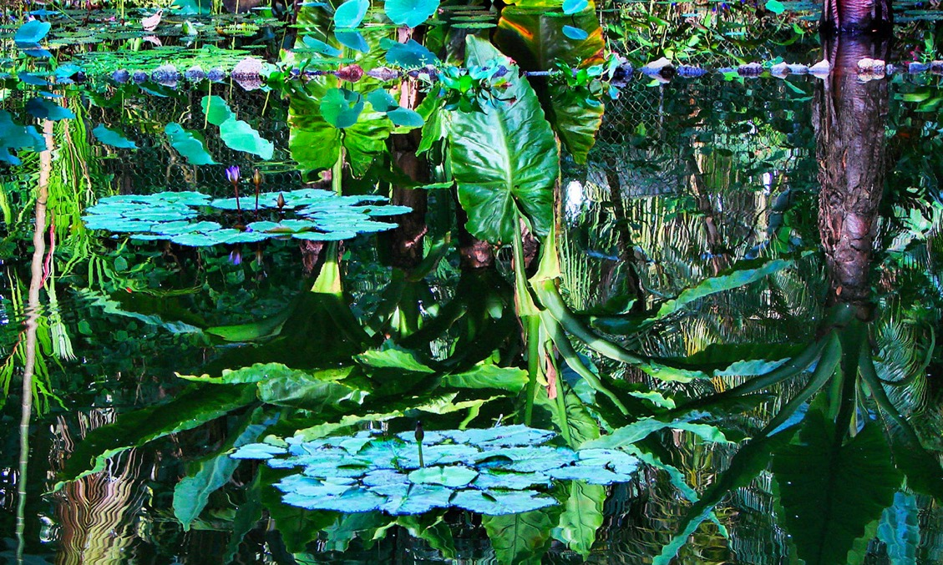

“Black holes are simpler than forests and Science has its limits”
Sir Martin Rees
(Astronomer Royal)
“More is different” (Anderson, Science 1972)

Slide 23
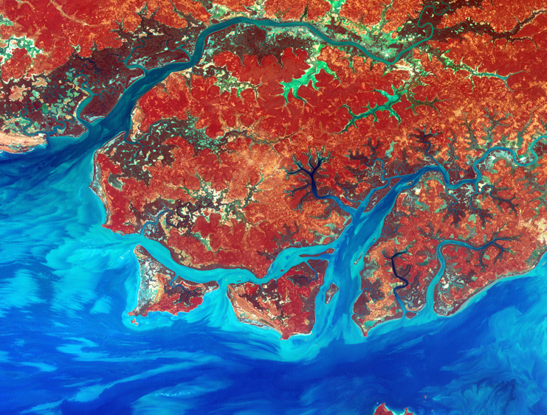
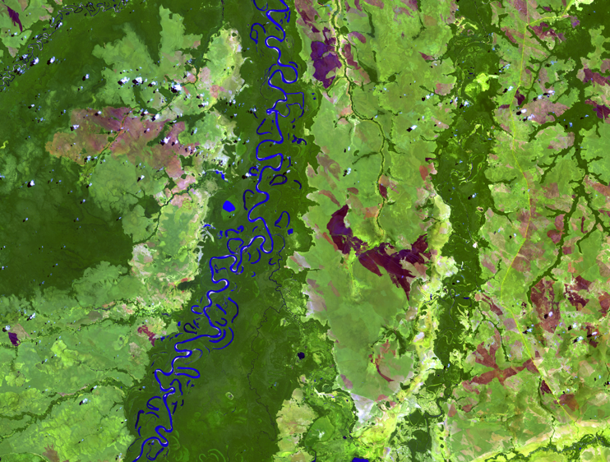
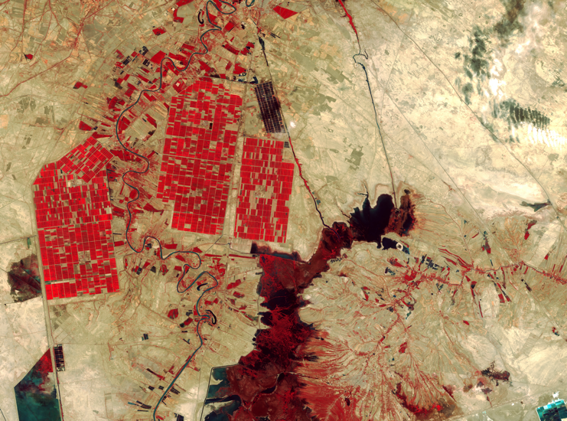
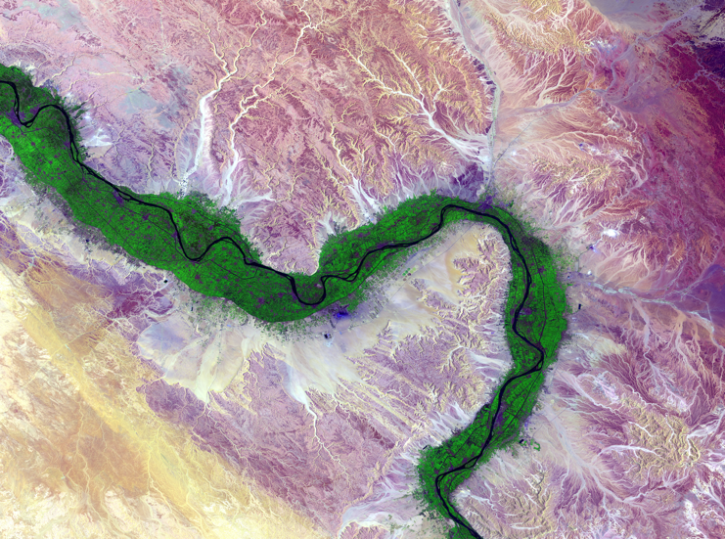
What is the semantic content of information measured by big Earth observation data?
images: USGS

Slide 24
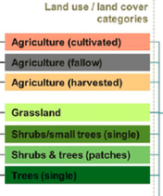
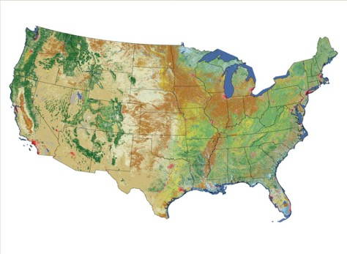
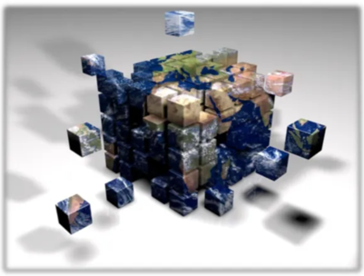
From reality to representation
reality
ontologies
classification
measurements
Data organisation
Data analysis

Slide 25
What are the limits of machine learning?
What works for face recognition, automatic translation, and Chess/Go games does also work for big spatial data?
image: manmax31.github.io

Slide 26
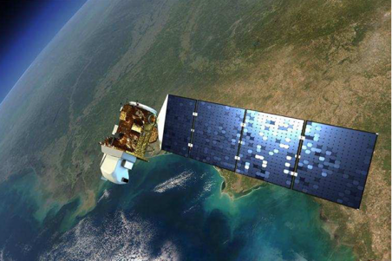
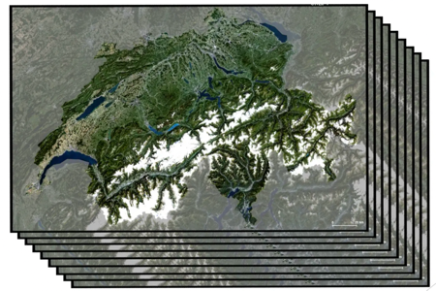
Big spatial data for sustainable development: Earth observation images
Big satellite data
(2PB per day)
Data cubes
(space-time fields)
Machine learning
(classification)
In what ways is big spatial data special?
images: NASA, Swiss Data Cube, ECMWF

Slide 27
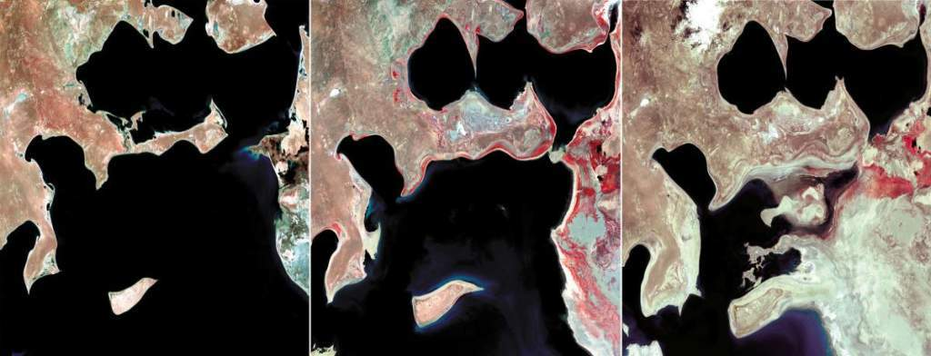
What’s in an image?
“A remote sensing image is a measurement that captures snapshots of change trajectories. The focus of the ontological characterization of images should be on searching for changes instead of searching for content.” (Camara et al, COSIT 2001)
images: USGS

Slide 28
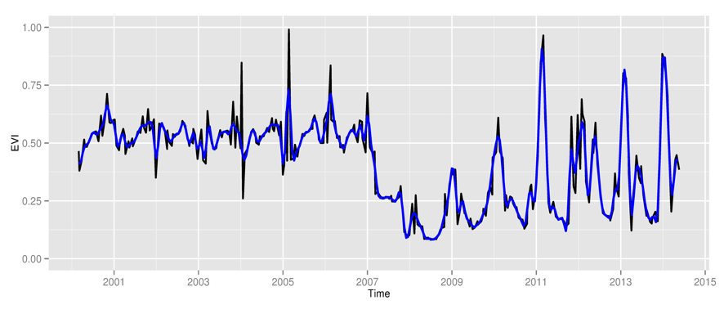
Space first, time later or time first, space later?
Space first: classify images;
compare results in time
Time first: classify
time series; join results to get maps
graphics: V Maus, author

Slide 29
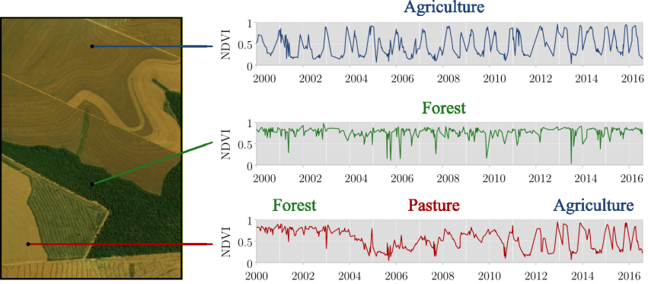
Land-use change trajectories measured by time series
“Transformations of land cover due to actions of land use” (continuous monitoring of landscapes)
graphics: Rolf Simoes (INPE)

Slide 30
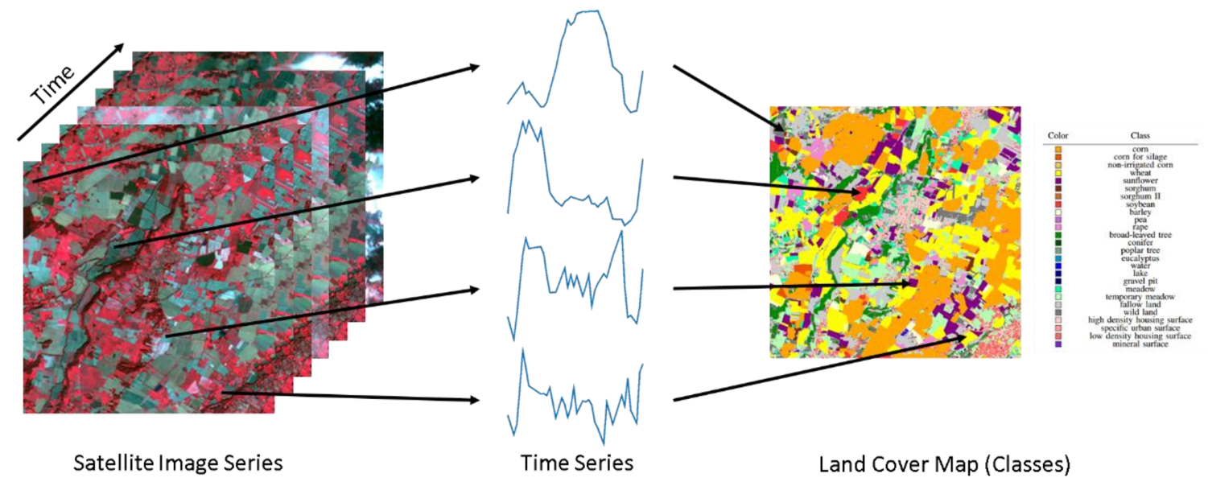
Using time series to estimate land use and land cover change
Extract samples from a data cube
Train a machine learning model
Classify all time series for a chosen period
image: F Petitjean, Monash Univ

Slide 31


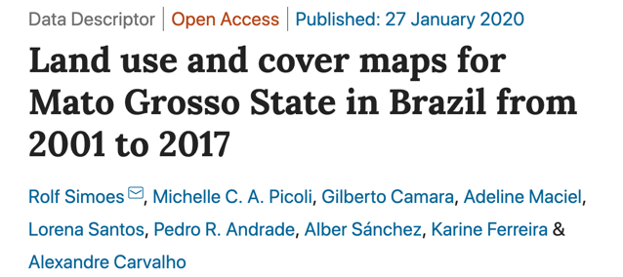
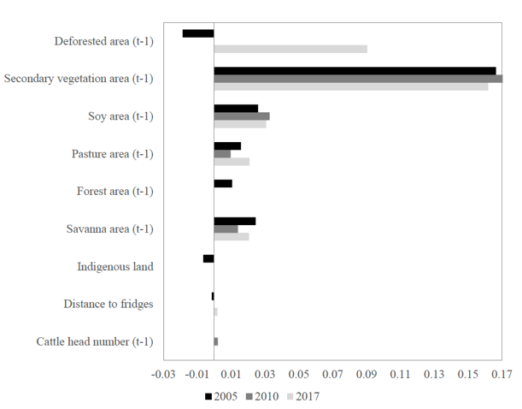

Finding: Machine learning is useful for big EO data, but…
Pasture expansion

Slide 32

Cerrado: Brazilian Savanna
covers 2 million km², latitude ranges from 5⁰S to 25⁰S
image: TerraClass, INPE/EMBRAPA

Slide 33




Cerrado: Brazilian savanna
Open cerrado
Cerrado strictu sensu
Cerradão (dense woodland)
images: Del-Claro and Silingardi (Annals Brazilian Academy Sci, 2019 ), Schwieder et al. (IJAEOG, 2016)

Slide 34

Too good to be true?
Model | 5-fold validation accuracy
SVM | 97.6%
Random Forest | 98.5%
Perceptron | 99.2%
FCNN | 98.9%
tempCNN | 99.1 %
ResNet | 99.0%
Brazilian Amazonia – MODIS data
33,000 samples
Models fit samples well, but do they represent reality?
data: Simoes and Camara (2020)

Slide 35


Machine learning in simulated landscapes
Small variability: easy for ML
Large variability: hard for ML
Machine learning relies on optimization and works best on problems with low variability
source: Coveney et al., “Big data need big theory too” (2017)

Slide 36
The ghost of overfitting
SVM (support vector machines) have seven (7) tuning parameters. Other machine learning methods are similar. Overfitting is easy to occur.
graphics: Patni (medium.com)

Slide 37


Data-rich, theory poor
Freeman Dyson
Enrico Fermi
Fermi: How many parameters did you use in your calculations?
Dyson: Four.
Fermi: My friend John von Neumann used to say that with four parameters, I can fit an elephant and with five, I can make him wiggle his trunk.
images: NYT, Wikipedia

Slide 38

The Elephant in the savanna
The elephant in the room
Big satellite data
(2PB per day)
Data cubes
(space-time fields)
Machine learning
(classification)
Ecosystems are highly variable
Local knowledge is essential
images: Alamy, NASA, Swiss Data Cube, ECMWF

Slide 39
How to find out if our samples are good?
Alves et al. (in preparation), “Quality control and class noise reduction of satellite image time series”

Slide 40

Using SOM to find out ecological differences
Alves et al. (in preparation), “Quality control and class noise reduction of satellite image time series”

Slide 41
The limits of our concepts
“The gradation of properties in the world means that our smallish number of categories will never map perfectly onto all objects” (Murphy, The Big Book of Concepts, 2004)
image: Amazon, referral: O Ahlqvist

Slide 42



The ambiguity of “forest”
images: Alamy
Tropical forest
Temperate forest
Dry forest
Planted forest

Slide 43




A scientific question linked to public policy
When is a forest not a forest?
images: Alamy

Slide 44




Deforestation as an event
images: Alamy, INPE
Pristine forest
Degradation by logging
Degradation by fire
Clear-cut

Slide 45




Event composition
Forest loss > 20%
Exploração intensiva
time
Event 1
Perda >50% do dossel
Loss > 50%
Event 2
Perda >90% do dossel
Loss > 90%
Event 3
Corte raso
Event 4
Clear cut
Floresta
Floresta

Slide 46
Distinguishing forests by temporal evolution
source: Chazdon et al (2016)

Slide 47

Objects and events in land change
Space
Time
Continuants | Occurrents
Indigenous area | Deforestation
images: ISA, Greenpeace

Slide 48
Land-use change trajectories are measurements of events
How to extract events from time series?
graphics: Rolf Simoes (INPE)

Slide 49

Temporal patterns of different classes
graphics: author

Slide 50

Finding events in a remote sensing time series
“A Time-Weighted Dynamic Time Warping Method for Land-Use and Land-Cover Mapping” (Maus, Câmara et al, 2016)
“dtwSat R Package” (Maus et al., 2019)
graphics: V Maus (Univ of Vienna)

Slide 51

Finding breaks in time series (events)
BFAST: Detected changes in an 16-day NDVI time series for pine plantations (Verbesselt et al., 2010)
graphics: J Verbesselt

Slide 52
Proposed hierarchy of events linked to land use change
Caveat: names of high-level event types in the hierarchy are conflated with their measures
source: Camara, JOSIS 2020 (submitted)

Slide 53


source: Maciel et al, IJGIS (2019)

Slide 54

Year-by-year land classification
Classification does not consider recurring events
source: Maciel et al, IJGIS (2019)

Slide 55

Year-by-year land classification
After spatiotemporal calculus reasoning
source: Maciel et al, IJGIS (2019)

Slide 56

Findings
Nature’s diversity limits machine learning and big data apps
Understanding human-enviromental interactions is essential
Big data enables continuous monitoring (trajectories)
Trajectories are measurements of events
Event recognition replaces object identification in big data

Slide 57


Slide 58
Research agenda
How to identify ground samples that account for natural and social variation?
How to capture local knowledge in big EO data?
How to recognise events in big EO data?
How best to reason with events?
How to use conceptual models to propose sound APIs to deal with big EO data?
How to develop and share robust open source tools to work with machine learning and big EO data?
How to make these technologies useful to support sound environmental policies?

Slide 59
Backup slides

Slide 60


Standards need theory (and theory can come from good practices)
Dimensionally extended
9-intersection model
SF-SQL, GeoSPARQL, WFS, …

Slide 61
Functional programming in big EO data: foundation for a sound API
transform (map)
filter
reduce
Collection
Data Cube
Values
filter (C, 𝜋) → DC
map (𝜙, DC) → DC
reduce (𝜌, DC) → value
Is big EO data analysis an extended case of map-reduce?

Slide 62


Fields as a Generic Data Type
estimate: Position → Value
Instances of Position: space, time, and space-time
Instances of Value: numbers, strings, space-time

Slide 63

A field of fields (Argo floats in Southern Ocean)
Positions: space Values: trajectories (time  space)

Slide 64
source: USGS
Events are categories (Frank, Galton)
identity : id · a = a
composition : ∀a, ∀b, ∃c, c = a.b
associativity : a · (b · c) = (a · b) · c

Slide 65
source: USGS
Events are categories (Frank, Galton)
cause (a,b) = effect (b,a)
before (a,b) = after (b,a)
on-commutativity : a · (b · c) /= (b.a) · c

Slide 66
Event composition
Forest loss > 20%
Exploração intensiva
time
Event 1
Perda >50% do dossel
Loss > 50%
Event 2
Perda >90% do dossel
Loss > 90%
Event 3
Corte raso
Event 4
Clear cut
Floresta
Floresta

Slide 67


“A few satellites can cover the entire globe, but there needs to be a system in place to ensure their images are readily available to everyone who needs them. Brazil has set an important precedent by making its Earth-observation data available, and the rest of the world should follow suit.”

Slide 68
Humans and machines on remote sensing
Humans
 | Easy | Hard
Easy | Water mask, fires | Time series
Hard | Space-time objects | Cause-effect
Machines

Slide 69

Forest (FAO definition)
Land spanning more than 0.5 hectares with trees higher than 5 meters and a canopy cover of more than 10 percent, or trees able to reach these thresholds in situ. It does not include land that is predominantly under agricultural or urban land use.

Slide 70

A working definition of big data
≈
n << all Statistics: we have a small part of the data
n == all Big brother: we have all the data (do we?)
n ≈≈ all Big data: we have data close to problem size

Slide 71
Limits of our models
Uncertainty on basic equations
Quantum
Gravity
Social and Economic
Systems
Particle
Physics
Living Systems
Global Change
Chemical
Reactions
Hydrological
Models
Solar System Dynamics
Meteorology
Complexity of the phenomenon
source: John Barrow
(after David Ruelle)

Slide 72


From research to decision-making
Research
Decision-making
problem-based
innovative
objective
outcome-based
compromise
best guess
Valley of Death

Slide 73
Occurrent
Land Use Change Trajectory
Sugarcane
Grain production
Cattle raising
Functioning
Functioning
Functioning
Biofuels and sugar
Cash crop
Food production

Slide 74
Collaborative e-science
Connect expertise from different fields
Make the different conceptions explicit in space and time
Geography
Economy
Ecology
GIScience

Slide 75

A time series field (tsunami buoy)
positions: time values: R
An Australian Geoscience Data Cube
(Câmara et al., 2014)

Slide 76

A remote sensing image
positions: 2D values: R^{n}
(Câmara et al., 2014)
image: USGS

Slide 77

Mato Grosso, Brasil, May 8 – Jun 9, 1984

Slide 78

Mato Grosso, Brasil, Aug 13 – Sep 14, 1989

Slide 79

Mato Grosso, Brasil, Jul 12 – Aug 13, 1994

Slide 80

Mato Grosso, Brasil, Jun 9 – Jul 11, 2000

Slide 81

Mato Grosso, Brasil, Jun 9 – Jul 11, 2004

Slide 82

Mato Grosso, Brasil, May 9 – Jun 10, 2006

Slide 83

Mato Grosso, Brasil, Jun 9 – Jul 11, 2008

Slide 84

Mato Grosso, Brasil, Jun 10 – Jul 12, 2010

